Slide 1

ADSP 32014 IP01: Bayesian Machine Learning
Modeling Heart Failure Risk Using Bayesian Networks
A probabilistic approach to clinical decision support and uncertainty quantification.
Yukai Huang, Heath Liao
1

Slide 2


The Clinical Challenge
Heart failure remains a leading cause of mortality globally. Early and accurate risk identification is critical for timely intervention.
Problem: Traditional clinical decisions often rely on static rules or "black-box" ML models.
Gap: Standard ML models (like Logistic Regression) lack direct interpretability and often fail to quantify uncertainty.
Goal: Develop a transparent, probabilistic model that supports evidence-based medical decision making.
2

Slide 3






Why Bayesian Networks? (Methodology Rationale)
Bayesian Networks (BNs) offer a generative approach that models the full joint probability distribution of all risk factors, ideal for high-stakes domains.
Causal Structure
Quantified Uncertainty
White-Box Interpretability
BNs explicitly model conditional dependencies (like a causal graph) between clinical factors via Directed Acyclic Graphs (DAGs).
Provides fully calibrated posterior probability estimates
P(HD=1 | evidence)
The reasoning path is transparent via the Conditional Probability Distributions (CPDs), directly supporting clinician trust and adoption.
3

Slide 4

Data & Preprocessing for Bayes Network(BN)
Data Source
Example Discretization Bins
Heart Failure Prediction Dataset (Kaggle)
Age: {<40, 40-55, 55-70, ≥70}
N = 918 real-world patient records.
RestingBP: {<120, 120-140, 140-160, ≥160}
Features: 11 clinical features (Age, Cholesterol, RestingBP, FastingBS, ST_Slope, etc.).
Cholesterol: {<200, 200-240, ≥240}
BN Key Step: Clinical Discretization
Note: Discretized features were used for BN structure/parameter learning.
BN models perform best with discrete data. Continuous features were converted to clinically relevant, interpretable bins, improving model alignment with medical standards.
4

Slide 5
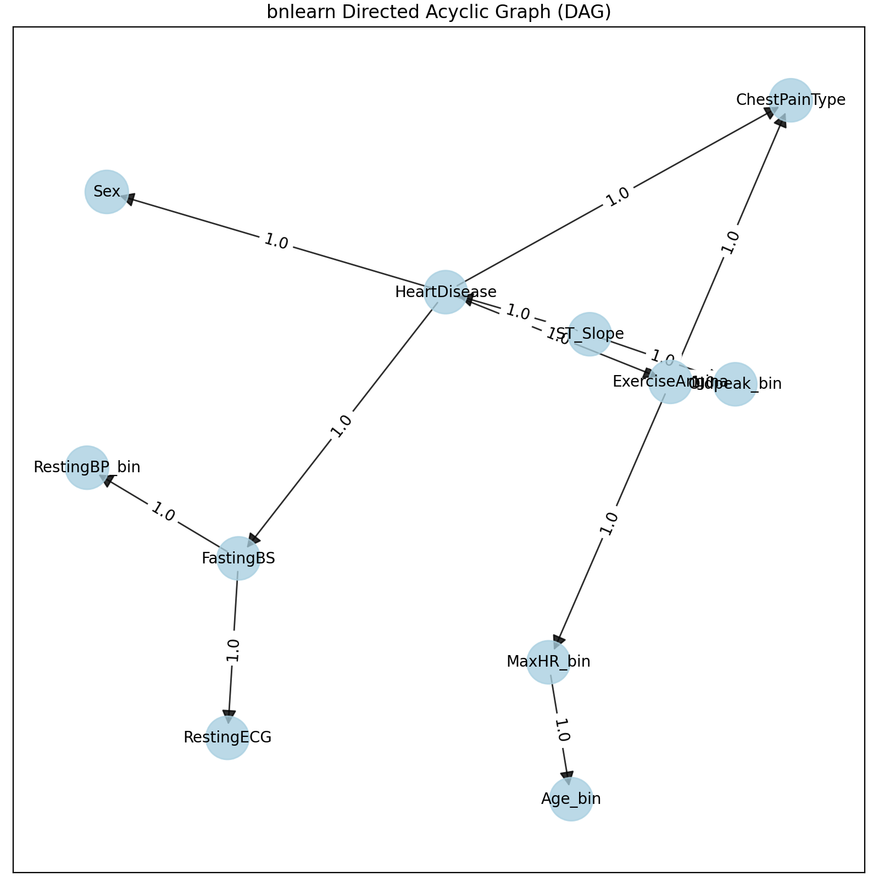
Model Training & Learned Structure
The structure learning algorithm was applied to the discretized training data (80% split) to identify the network dependencies.
Key Edges Discovered:
ST_Slope → HeartDisease: Strong influence of ECG results on diagnosis.
Oldpeak_bin → ExerciseAngina: Reflecting the interconnectedness of stress test results.
HeartDisease → Sex / FastingBS: Suggesting conditional dependence of these factors given the diagnosis.
Model: `bnlearn` & `pgmpy`. Structure Learning: Hill-Climbing (BIC Score). Parameter Learning: Bayesian Estimation (Dirichlet Priors).
5

Slide 6


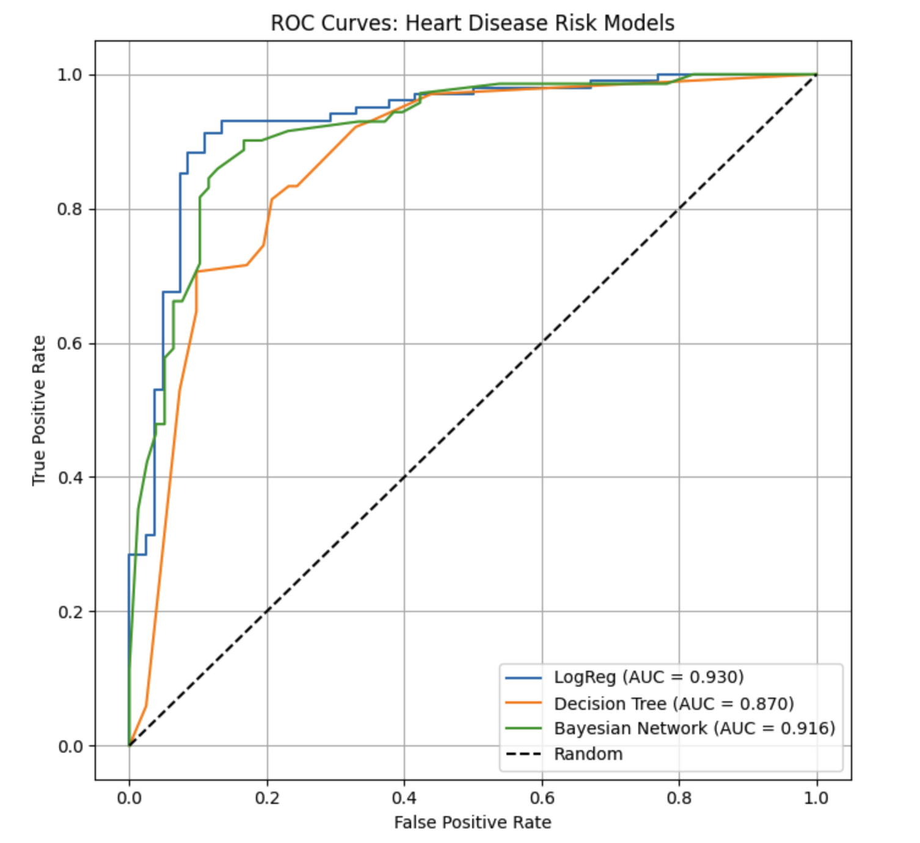
Discrimination Performance (ROC-AUC)
The BN's ability to rank patients by risk (discrimination) is highly competitive with traditional models, validating its predictive strength.
0.930
0.916
Logistic Regression AUC
Bayesian Network AUC
Key Insight: The BN, despite using discrete data and offering full interpretability, nearly matches the performance of the best-performing black-box model (LogReg).
*ROC-AUC measures the model's ability to distinguish between positive and negative classes.
6

Slide 7
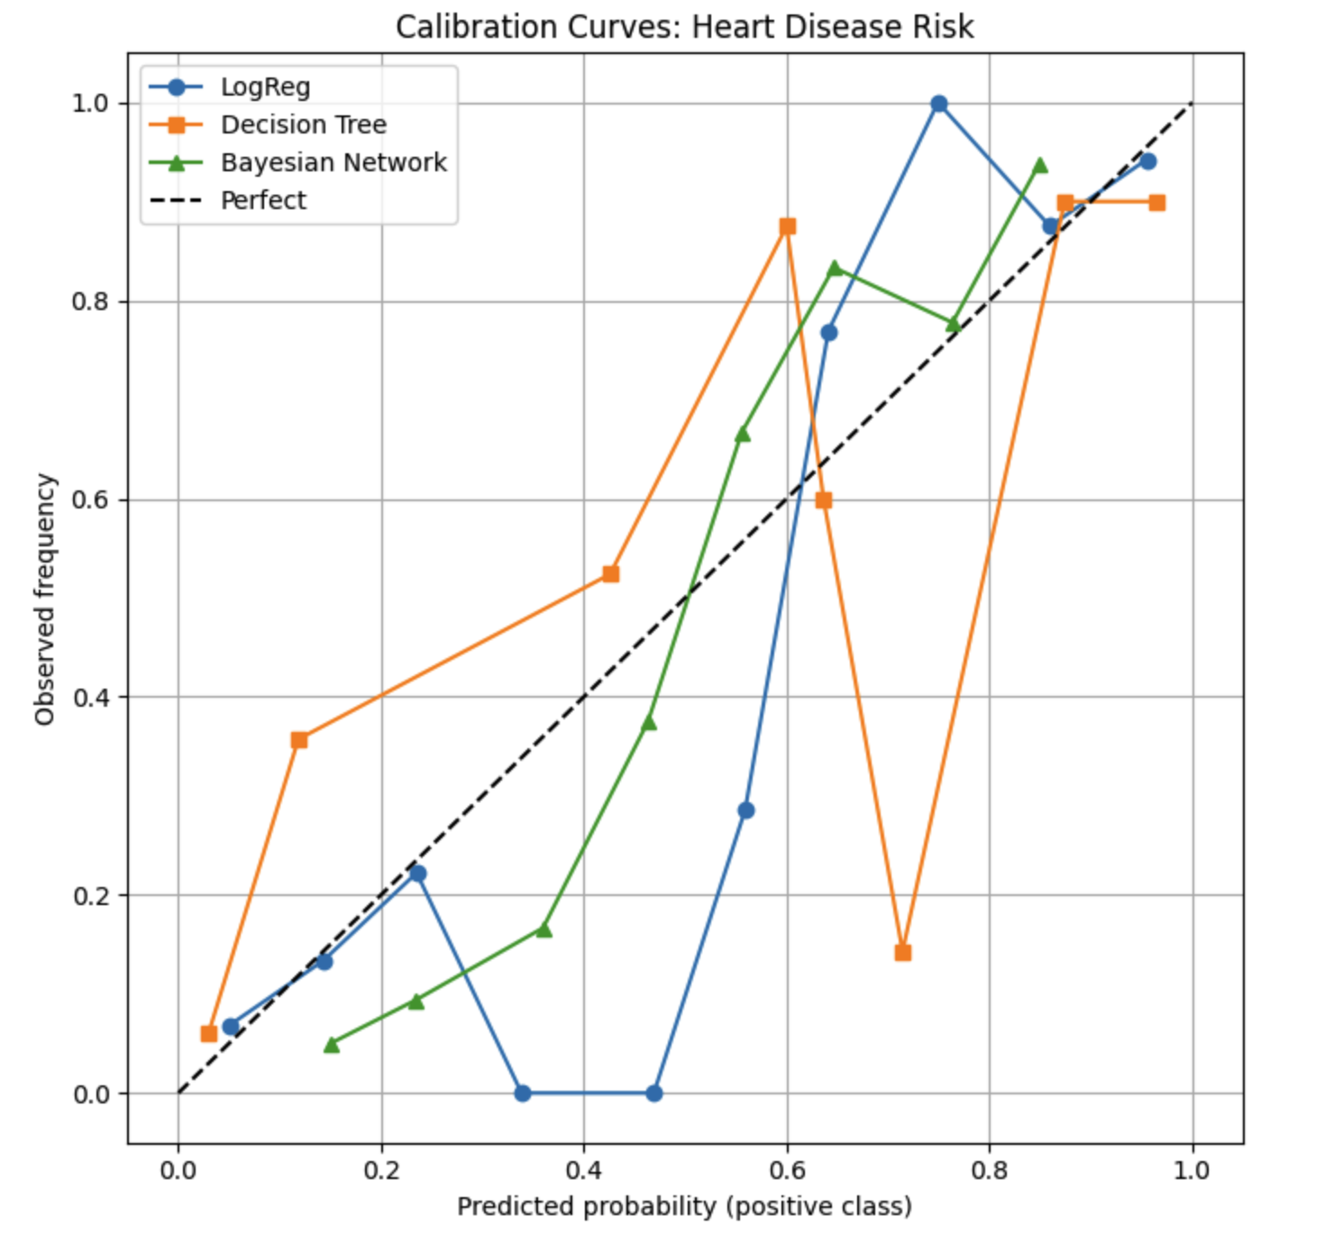

Trust & Calibration
In clinical practice, a well-calibrated model is essential: a 70% predicted risk must correspond to a 70% observed frequency of disease.
Key Finding (Probabilistic Reliability)
The Bayesian Network (Green Line) tracks the ideal "Perfect" line more closely than the Decision Tree (Orange) and exhibits highly stable calibration, especially in the crucial mid-range risk probabilities.
7

Slide 8
Detailed Benchmark Metrics (Uncertainty & Accuracy)
A comparison of three models on predictive error (Brier Score) and overall classification accuracy on the test set.
Metric Summary
Conclusion from Metrics
Model | ROC-AUC (Discrimination) | Accuracy | Brier Score (Calibration Error)
Logistic Regression | 0.930 | 0.886 | N/A (Not provided in output)
Decision Tree (Max Depth 4) | 0.870 | 0.804 | N/A (Not provided in output)
Bayesian Network | 0.916 | N/A (Prediction not explicitly shown) | 0.125
The BN (0.916 AUC) is robust and maintains high discrimination.
The low Brier Score (0.125) confirms the BN's probabilities are highly reliable.
The BN offers the best blend of predictive power and statistical reliability/interpretability.
8

Slide 9




Interpretable Inference (Variable Elimination)
The BN allows clinicians to perform transparent, scenario-based probabilistic queries to guide diagnostics.
Scenario 1: Elderly with Symptoms
Scenario 2: Young, Healthy ECG
Evidence: Age $\ge$ 70 AND Exercise Angina = Yes
Evidence: Age $<$ 40 AND ST\_Slope = Up AND Oldpeak $\le$ 0
$P(\text{HeartDisease} = 1 \mid \text{Evidence}) = 0.588$
$P(\text{HeartDisease} = 1 \mid \text{Evidence}) = 0.265$
(Query shows a high likelihood of disease given the compounded risk factors.)
(Protective factors significantly lower the estimated risk, providing transparent justification.)
9

Slide 10

Generative AI Application: Synthetic Data
As a generative model, the BN can be used to simulate realistic patient data, a key application in ADSP.
Conditional Sampling (Rejection Sampling)
We generated 1,000 synthetic patient profiles conditioned on evidence (e.g., Age $\ge$ 70) to model specific patient cohorts.
# Generating Synthetic Cohort
sampler = BayesianModelSampling(bn)
synthetic_data = sampler.rejection_sample(
Research Utility: Augmenting small datasets for rare subgroups.
evidence=[('Age_bin', '>=70')],
size=1000
Privacy Utility: Sharing statistical properties of patient data without exposing real PHI (Protected Health Information).
)
> Generated 1000 samples.
> Empirical Risk: 47.6%
Validation: The empirical risk (47.6%) derived from samples aligned with the analytical inference results.
10

Slide 11


Conclusion & Future Work
Summary
The Bayesian Network is the optimal model for this high-stakes task, providing an unparalleled combination of predictive power, robust calibration, and clinical transparency.
Performance: Achieved AUC 0.916 with low calibration error (Brier 0.125).
Interpretability: Supports exact probabilistic queries for transparent decision-making.
Generative AI: Demonstrates utility in synthetic data generation for medical research.
Thank You. Q&A.
11

